Slide 1
TEAM VALEN
By global academy of technology, bengaluru
Ashwath Hegde
Bhooshitha P
Chinmayee S
Yograj A C
GitHub Repository
GitHub URL: https://github.com/Valen-2026-team/FloodGuard_AI
IBM Z Datathon

Slide 2
FloodGuard
Flood-risk prediction and emergency-response decision support
Simulation | Early warning | Digital twin | Response planning
Prepared from the submitted project notebooks

Slide 3
Project overview
A simulation-led prototype for anticipating zone-level flood service failures
01
Simulate
02
Understand
Generate multi-zone flood and infrastructure conditions over a 72-hour horizon.
Explore failure causes, scenario severity and risk-associated features.
03
Predict
04
Decide
Train an early-warning classifier to flag zones likely to fail within 6 hours.
Compare response strategies and surface prioritized high-risk zones.
Scope note: results are from a simulated environment, not validated live-city forecasts.
2

Slide 4
End-to-end workflow
Notebook sequence and the role of each stage
01 • Simulation
02 • EDA
03 • Baseline model
04 • Digital twin
05 • IBM integration
06 • Dashboard & checks
200 scenarios × 72 hours
›
Failure patterns & associations
›
Group split by scenario
›
Compare interventions
›
Prepare situation report
›
Review outputs and replay
763,200 zone-hour records
Severity, causes, feature signals
19 features; early-warning classifier
75 runs across 5 strategies
Cloud/model credentials unavailable in run
Replay consistency checks passed
The project uses the same scenario seeds for fair intervention comparisons and checks scenario overlap in the model split.
3

Slide 5
Simulation dataset
Synthetic flood and service-failure scenarios
200
72 h
763,200
20
scenarios
per scenario
zone-hour rows
columns recorded
Generated indicators include flood depth, road accessibility, shelter distance/occupancy, supply levels, displacement and failure labels.
Across the combined simulated data: failed_now = 27.2%; will_fail_within_6h = 32.6%; isolated = 9.5%.
The simulation notebook reports a single-seed failure rate of 0.327 and a maximum of 7 isolated zones.
4

Slide 6
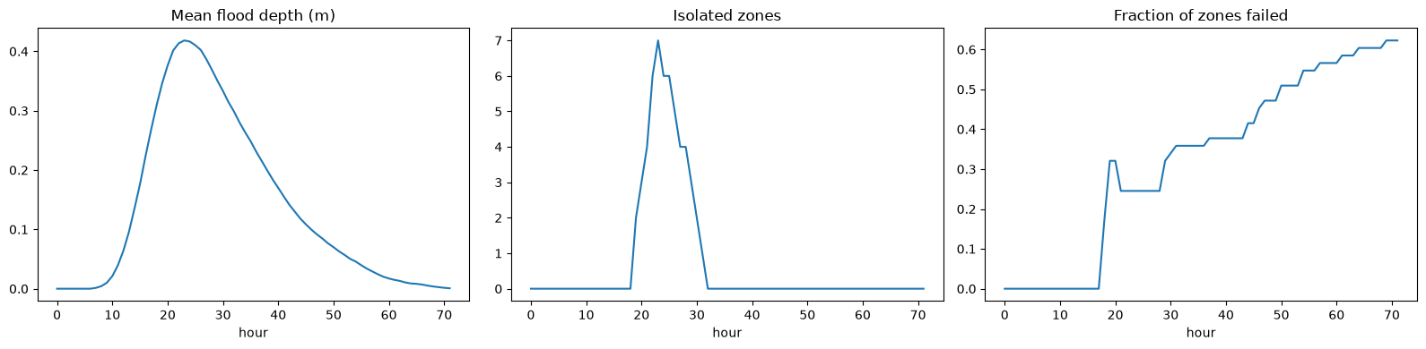
Simulated flood progression
mean flood depth, isolated zones and fraction of zones failed plot
5

Slide 7
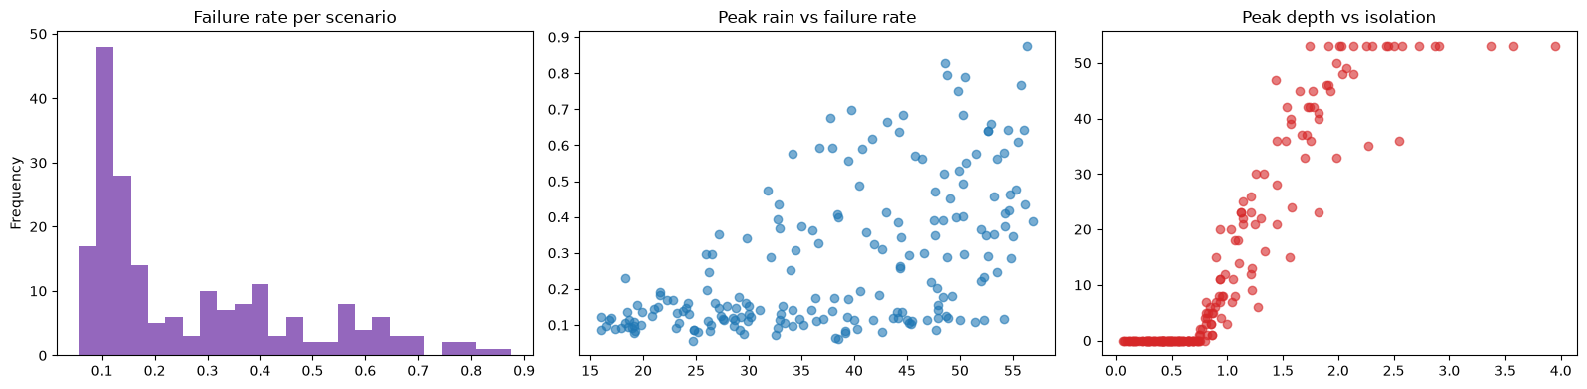
Exploratory analysis: causes & time to failure
six-panel plot
6

Slide 8
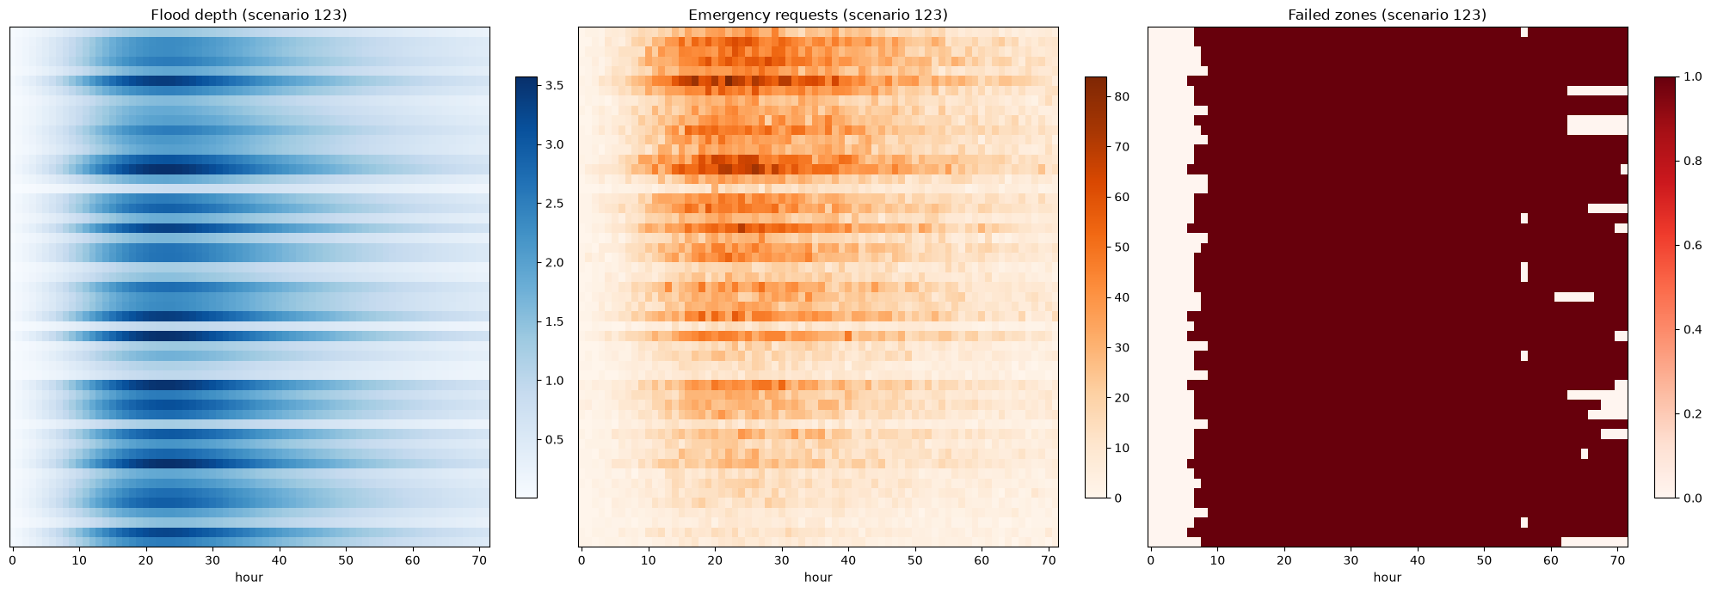
Exploratory analysis: scenario severity
scenario-level distributions and scatter plots
7

Slide 9
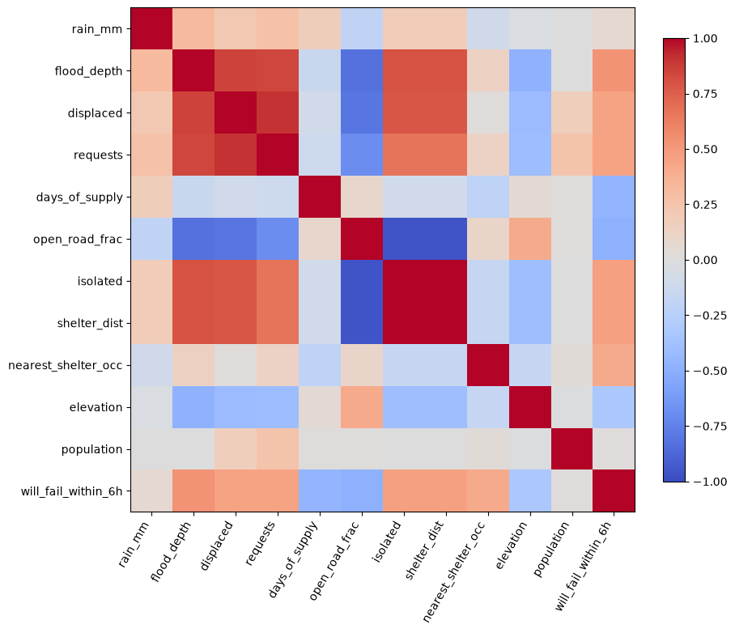
Exploratory analysis: feature relationships
correlation/relationship plot
8

Slide 10
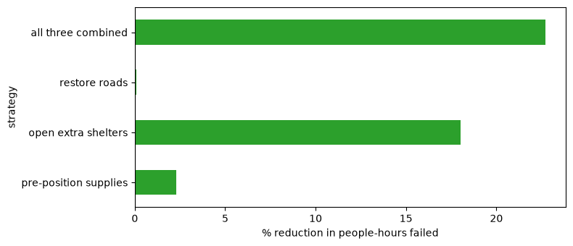
Digital-twin strategy comparison
intervention comparison plot
9

Slide 11
Early-warning model results
Evaluation report
Evaluation setup
Reported model metrics
763,200 rows; 19 input features.
Scenario-grouped train/test split; reported scenario overlap = 0.
Prediction target: failure within the next 6 hours for zones not already failed.
ROC-AUC
0.994
PR-AUC
0.942
Model @ 0.5 — precision / recall / F1
0.900 / 0.834 / 0.865
Model @ 0.3 — precision / recall / F1
0.838 / 0.883 / 0.860
Depth > 0.35 m rule — precision / recall / F1
0.259 / 0.458 / 0.331
10

Slide 12
Digital twin: intervention comparison
Mean outcomes across 75 runs on the 15 most severe seeds selected from 40 baseline runs
Strategy
People-hours failed
Isolated population-hours
Failed zone-hours
Zones ever failed
Baseline (do nothing)
3,617,305
1,198,000
1,584
43
Pre-position supplies
3,532,814
1,198,000
1,549
43
Open extra shelters
2,965,191
1,198,000
1,298
39
Restore roads
3,613,047
811,709
1,582
43
All three combined
2,794,547
811,709
1,223
37
Combined strategy: 22.7% fewer people-hours failed and 32.2% fewer isolated population-hours than baseline.
Opening extra shelters reduced people-hours failed by 18.0%; restoring roads reduced isolated population-hours by 32.2%.
Pre-positioning supplies alone produced a smaller change in these reported outcomes.
11

Slide 13
Example emergency situation report
selected high-risk decision point from the simulated data
Scenario 149
Hour 31
15 zones
32,592
selected scenario
decision point
high risk in next 6 h
people in high-risk zones
Prioritized actions surfaced by the notebook template
1
Zone 3_4
Population 1,433 • 100% risk • about 2 hours to failure
Main driver: supplies running low
2
Zone 3_5
Population 1,368 • 100% risk • about 5 hours to failure
Main driver: supplies running low
3
Zone 7_5
Population 1,490 • 84% risk • about 3 hours to failure
Main driver: rising flood water
Important: the IBM watsonx call was skipped because credentials were missing; this report came from the local template.
12

Slide 14
IBM integration and deliverables
Implementation status
Model artifacts
Local model files detected: features.joblib, ttf_reg.joblib and failure_clf.joblib.
Situation report
Generated from a deterministic template because no LLM backend was available.
watsonx.ai
Skipped: credentials missing (.env not found).
Cloud Object Storage
Not configured; files remained in the local outputs folder.
Output bundle
Notebook reports 14 local output/model/figure files saved.
Be transparent in the submission: IBM integration scaffolding is present, but authenticated cloud execution was not demonstrated.
13

Slide 15
Validation, limitations & conclusion
Final checks and project outputs
Deterministic replay matched flood depth to floating-point precision across tested seeds; road/isolation mismatches = 0.
Notebook checks report 0 isolated zones at hour 30 for the tested scenario; safest and fastest routes were reported as 19 min / 7 segments and 8 min / 2 segments respectively (fastest route maximum depth 0.37 m; safest 0.28 m).
The digital twin suggests the combined response strategy is the strongest of the tested options on the reported metrics.
Limitations: synthetic simulation, no real-world calibration evidence in the supplied notebooks, and missing credentials prevented live watsonx/COS execution.
Next step: validate against real flood and infrastructure data, then configure credentials and test the full operational integration.
14

Slide 16
THANK YOU
Team Valen
FloodGuard
AI-assisted flood-risk forecasting and emergency response planning

